Slide 1

Computer System Servicing

Slide 2
Disk Partitioning
Disk Partitioning or disk slicing is the creation of one or more region on secondary storage, so that each region can be managed separately. These regions are called Partitions.

Slide 3
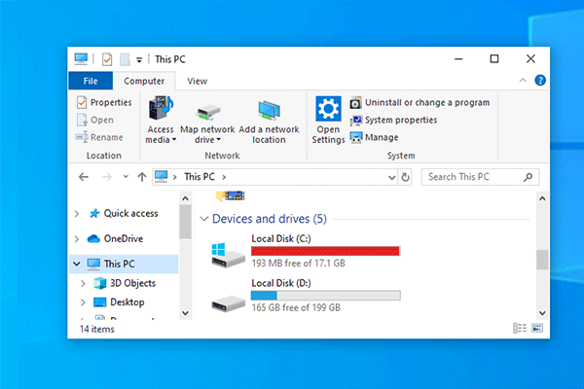
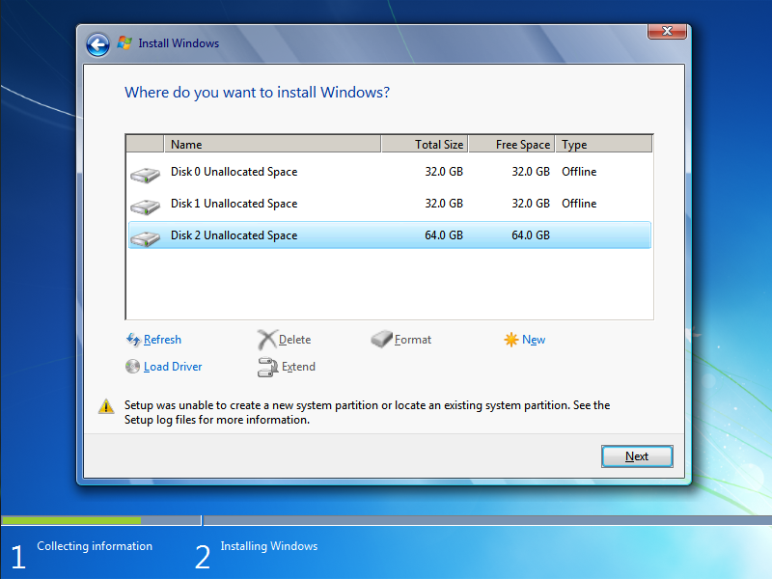
Disk Partitioning

Slide 4
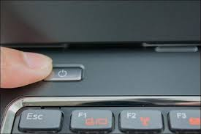
Installation of Windows 7
1. Turn On your Computer by Pressing the Power Button.

Slide 5
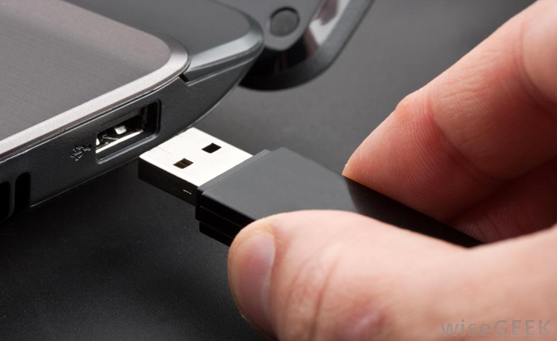
Installation of Windows 7
2. Insert the bootable USB in your USB port.
After Turned your computer ON, Insert the bootable USB Drive to the USB Port, and then Press certain key in your keyboard to go to BIOS Setup.

Slide 6
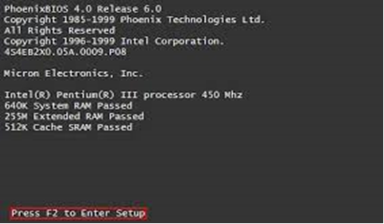
Installation of Windows 7
3. Enter your computer's BIOS. When the BIOS screen appears or you are prompted to do so, press Del, F1, F2, F10, or F9 (depending on your computer’s motherboard) to enter the system BIOS.

Slide 7
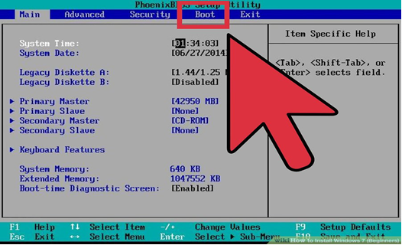
Installation of Windows 7
4. Choose Advanced BIOS Features/Startup/Boot Tab. To change the booting sequence of your computer.

Slide 8
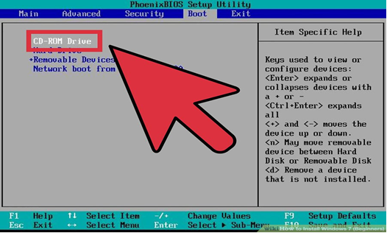
Installation of Windows 7
5. Select the Flash drive as the first boot device of your computer.

Slide 9
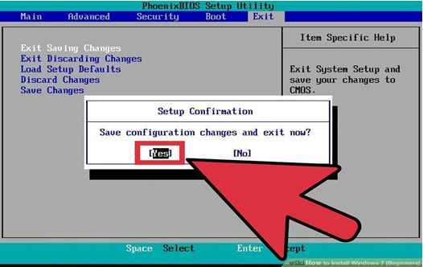
Installation of Windows 7
6. Press F10 ( Save and Exit)

Slide 10
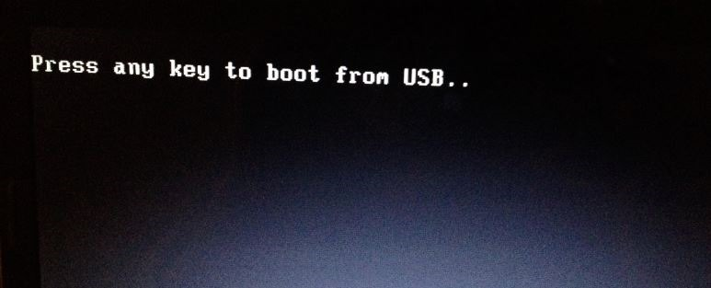
Installation of Windows 7
7. Press any key to boot from USB will appear (Press Spacebar)

Slide 11
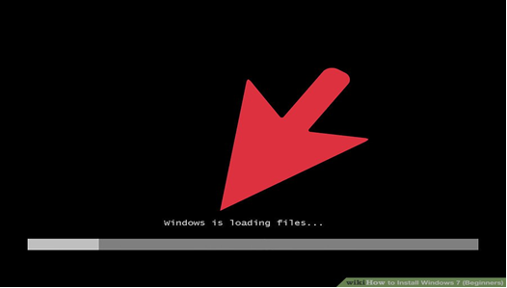
Installation of Windows 7
8. Windows is Loading Files will appear

Slide 12
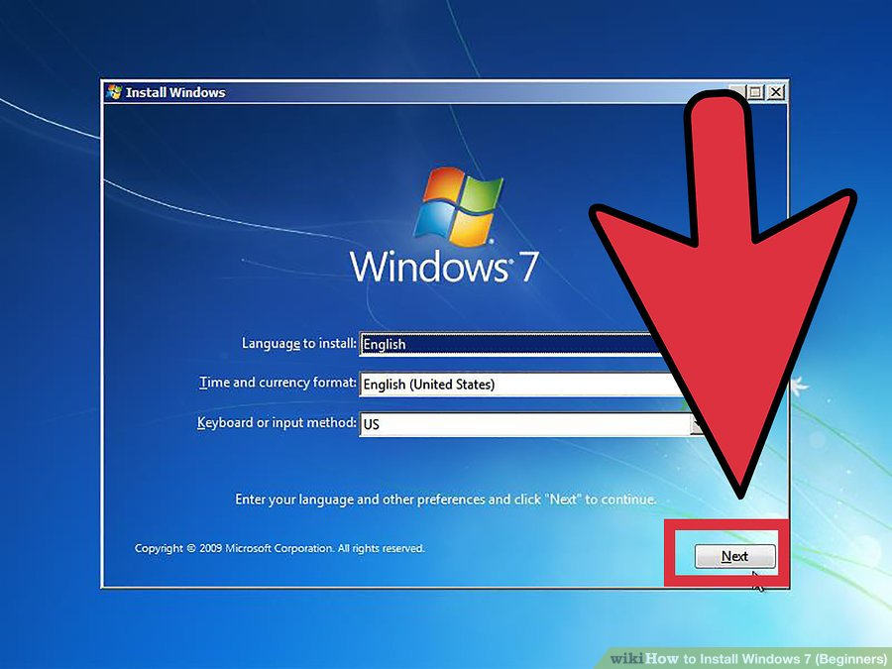
Installation of Windows 7
9. Language Option/Click Next

Slide 13
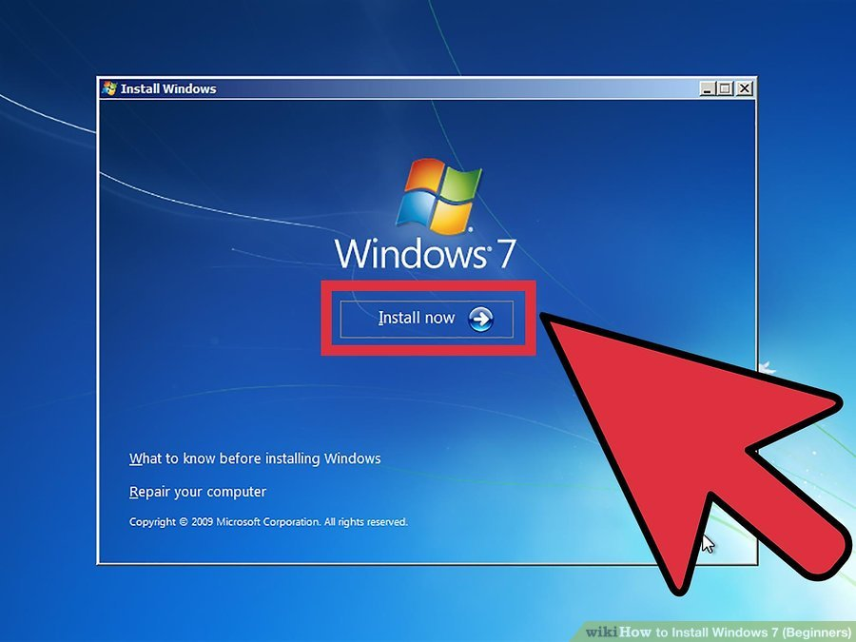
Installation of Windows 7
10. Click the Install Now button.

Slide 14
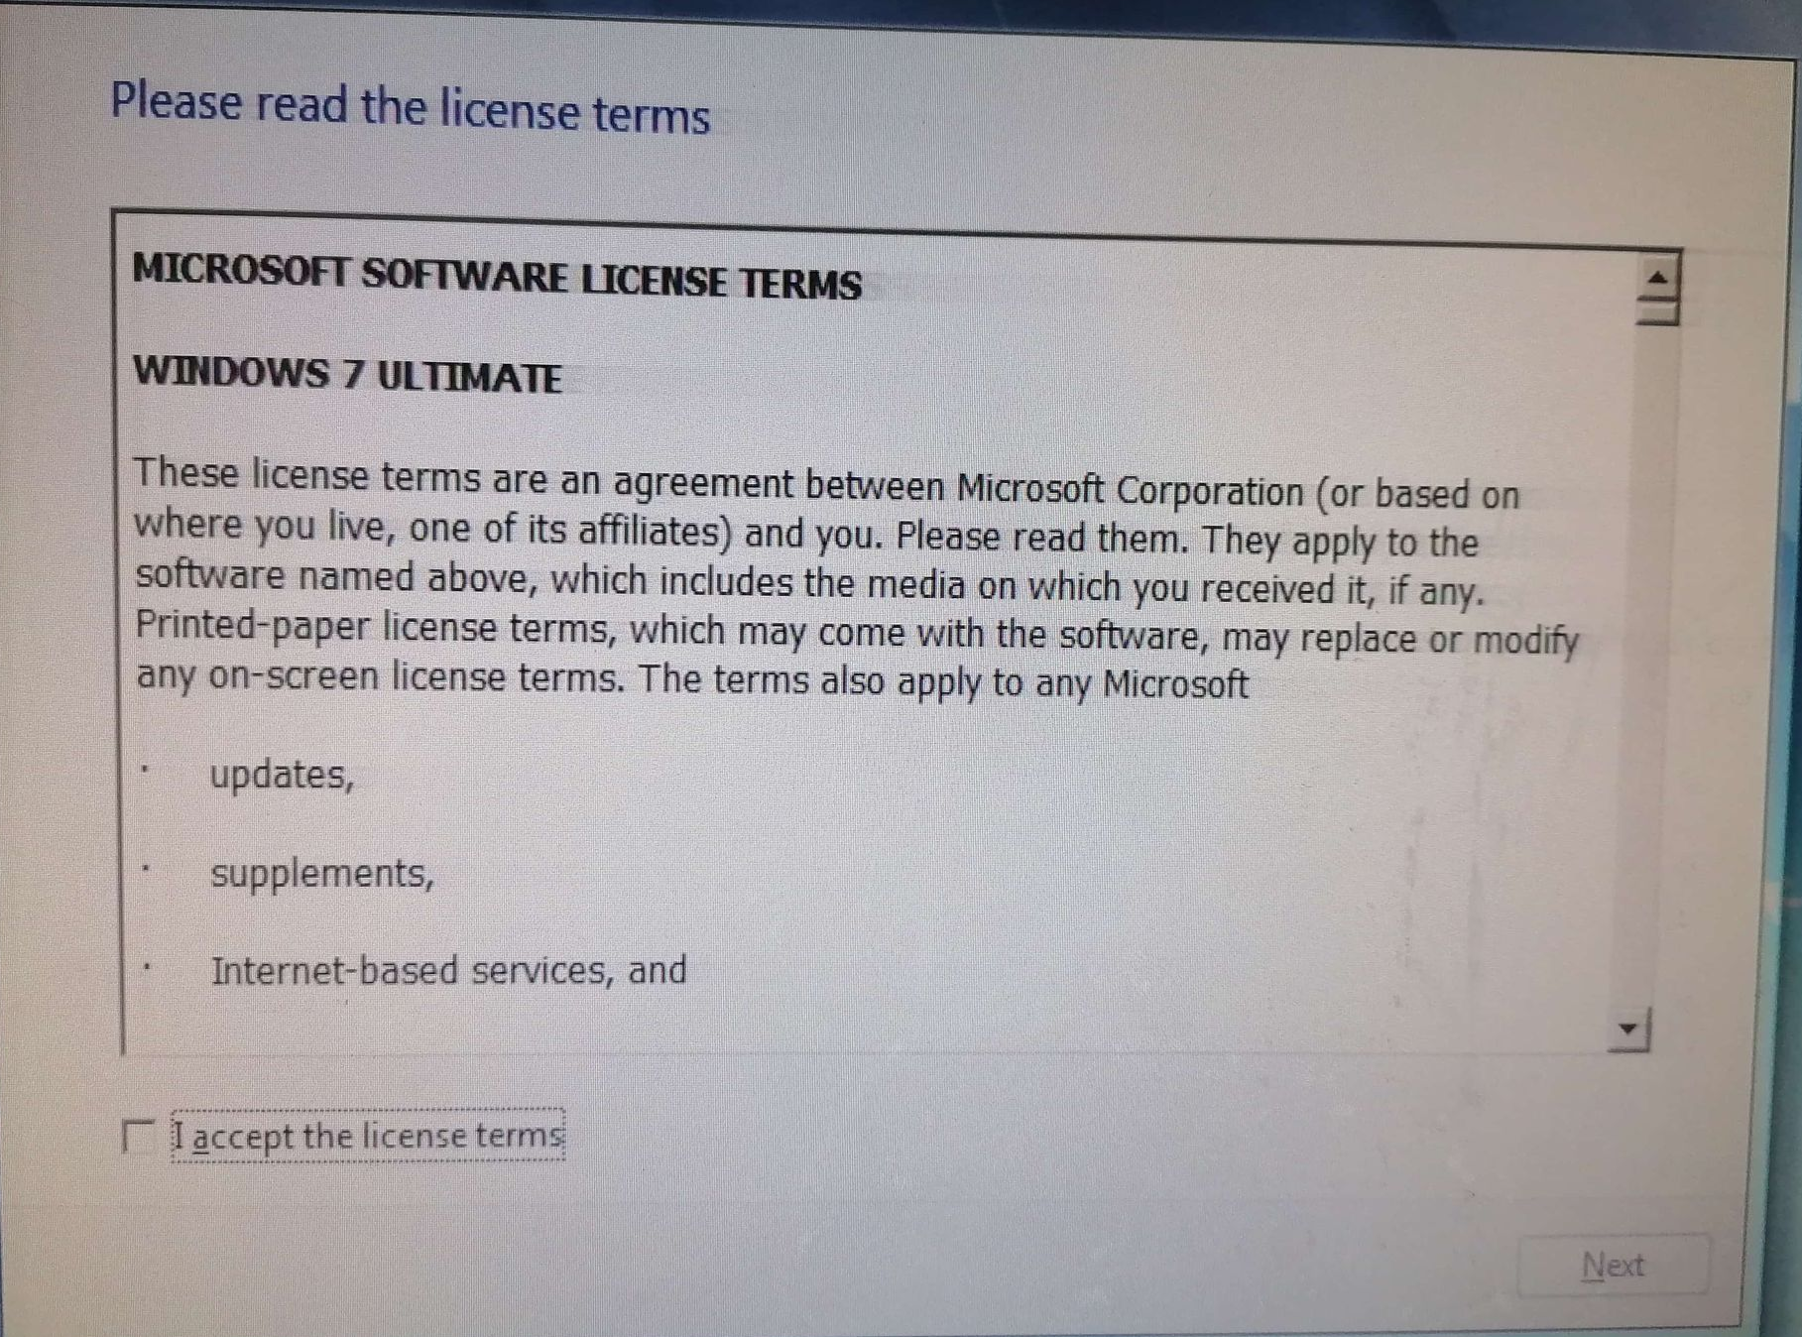
Installation of Windows 7
11. Licensing Agreement

Slide 15
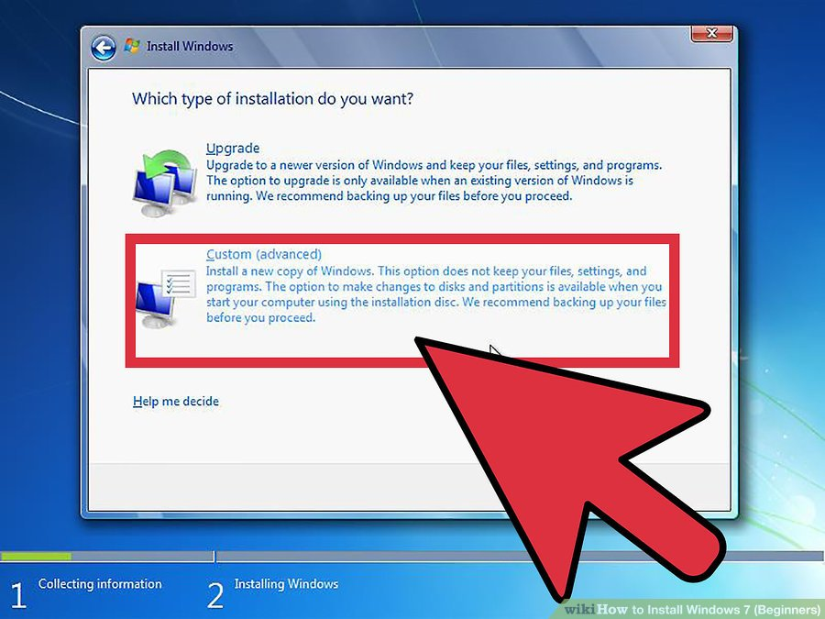
Installation of Windows 7
12. Select the Custom installation.

Slide 16
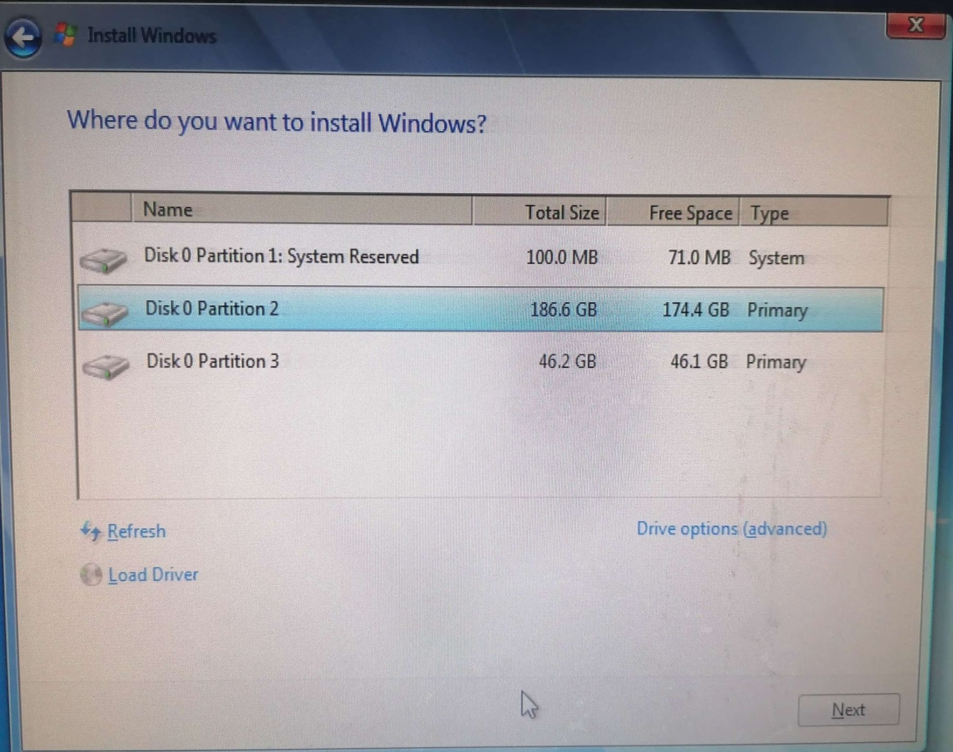
Installation of Windows 7
13. Hard Disk Partition will appear

Slide 17
Installation of Windows 7
14. Select Drive Option (Advanced)

Slide 18
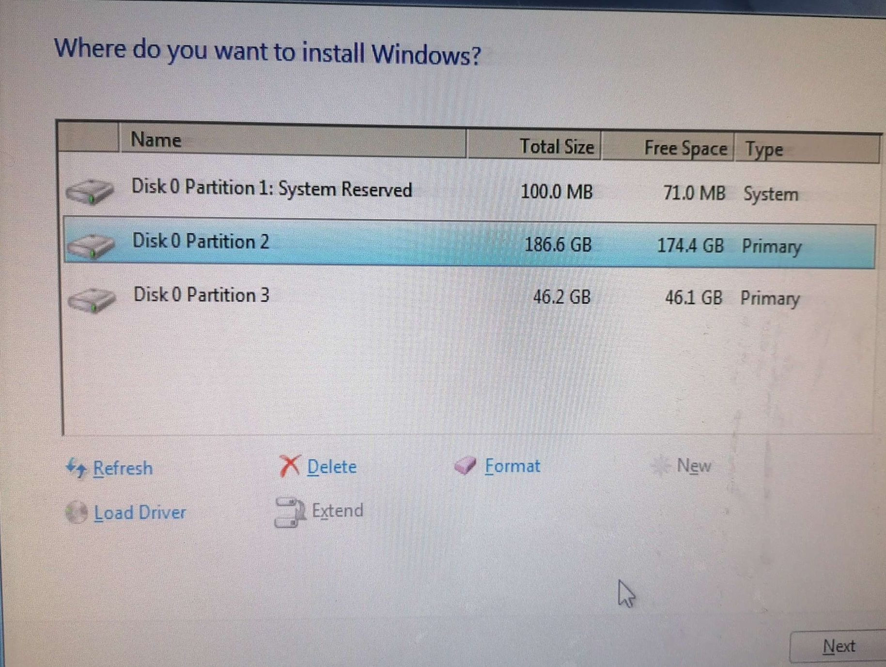
Installation of Windows 7
15. Select Partition 2 then click DELETE

Slide 19
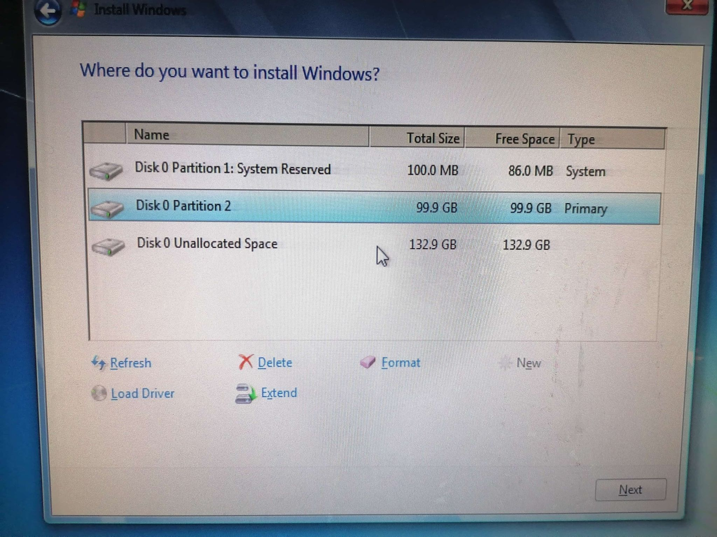
Installation of Windows 7
16. Select Partition 2 then click DELETE

Slide 20
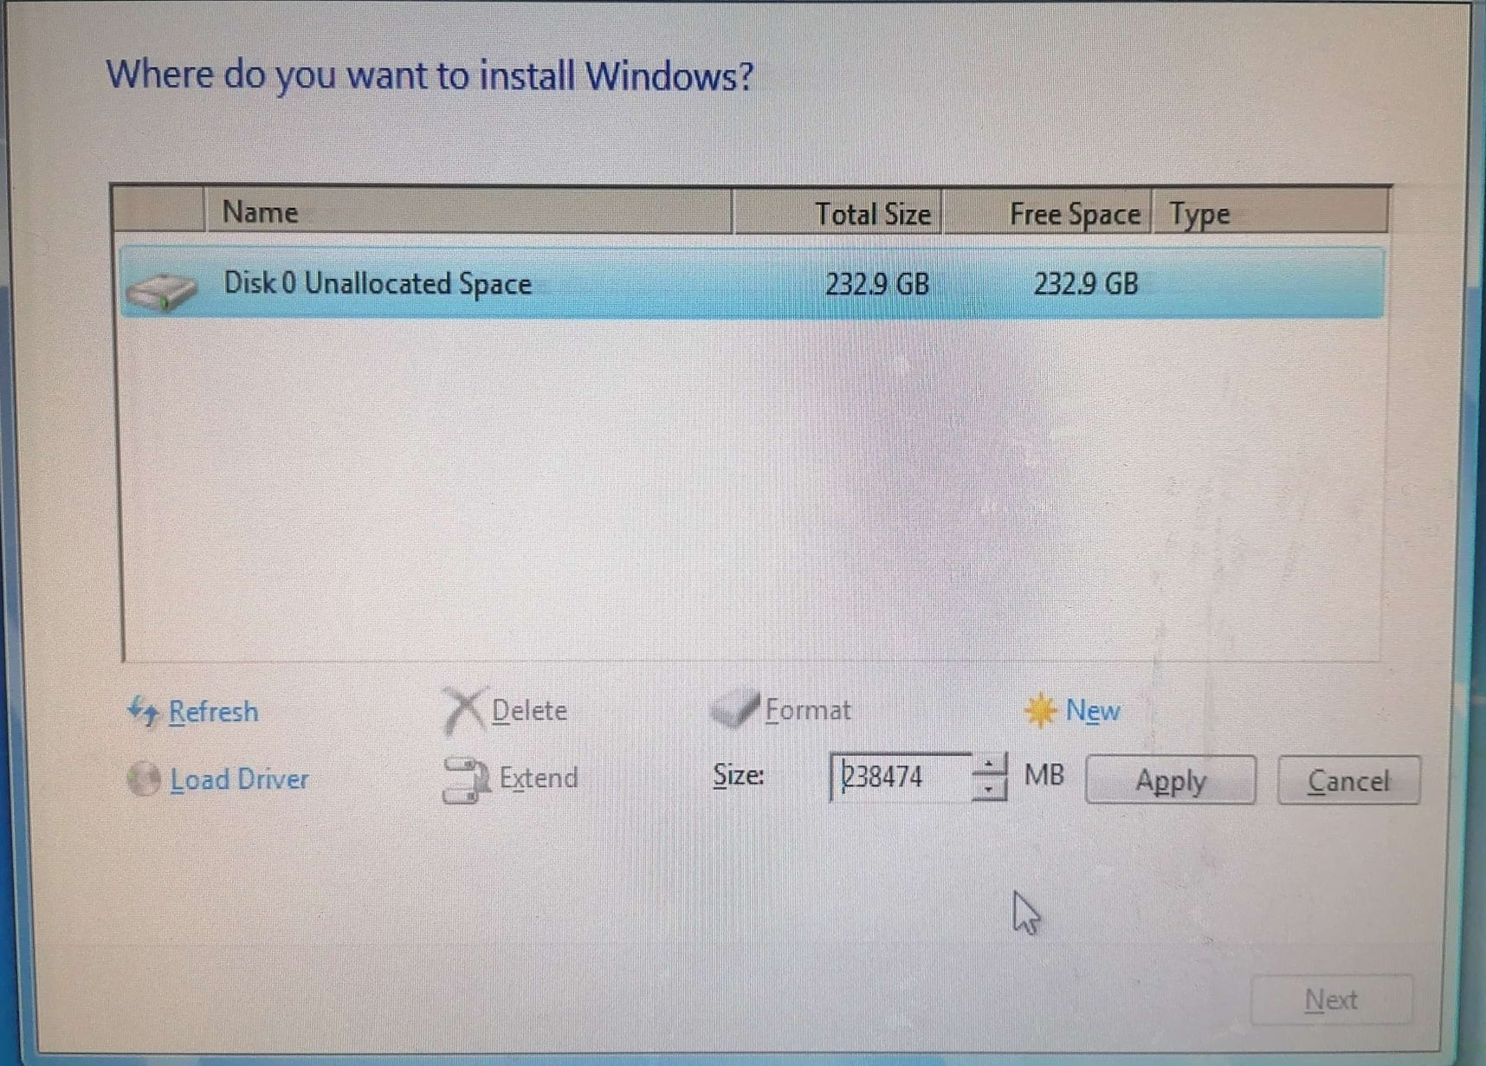
Installation of Windows 7
17. Select Partition 1 then click DELETE

Slide 21
Installation of Windows 7
18. All Partition was Deleted

Slide 22
Installation of Windows 7
19. Create Partition 2 or Local C:

Slide 23
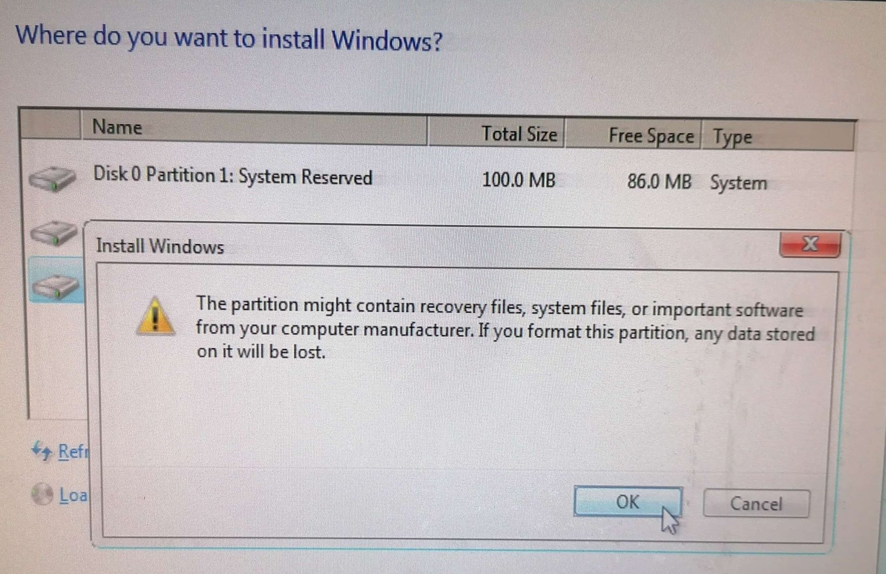
Installation of Windows 7
20. Select Unallocated click NEW to Create Partition 3 or Local D:

Slide 24
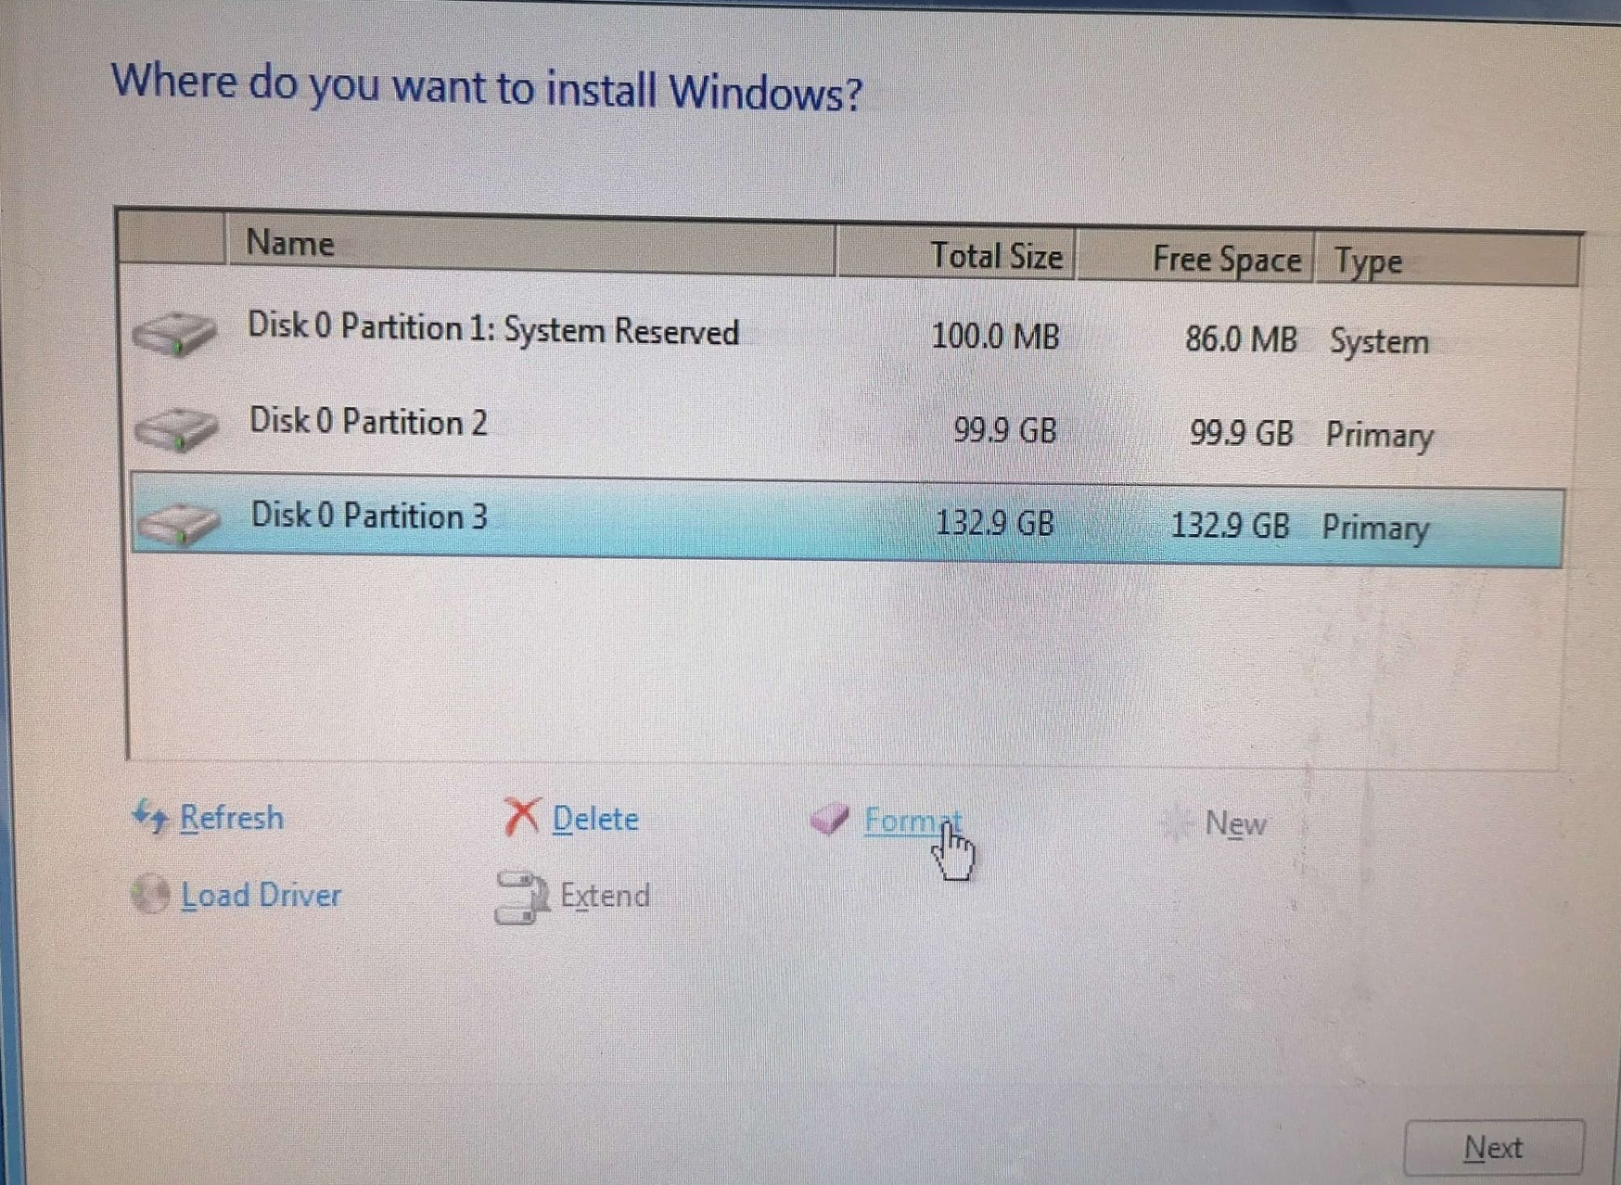
Installation of Windows 7
21. Select Partition 3 or Local D:, then click format

Slide 25
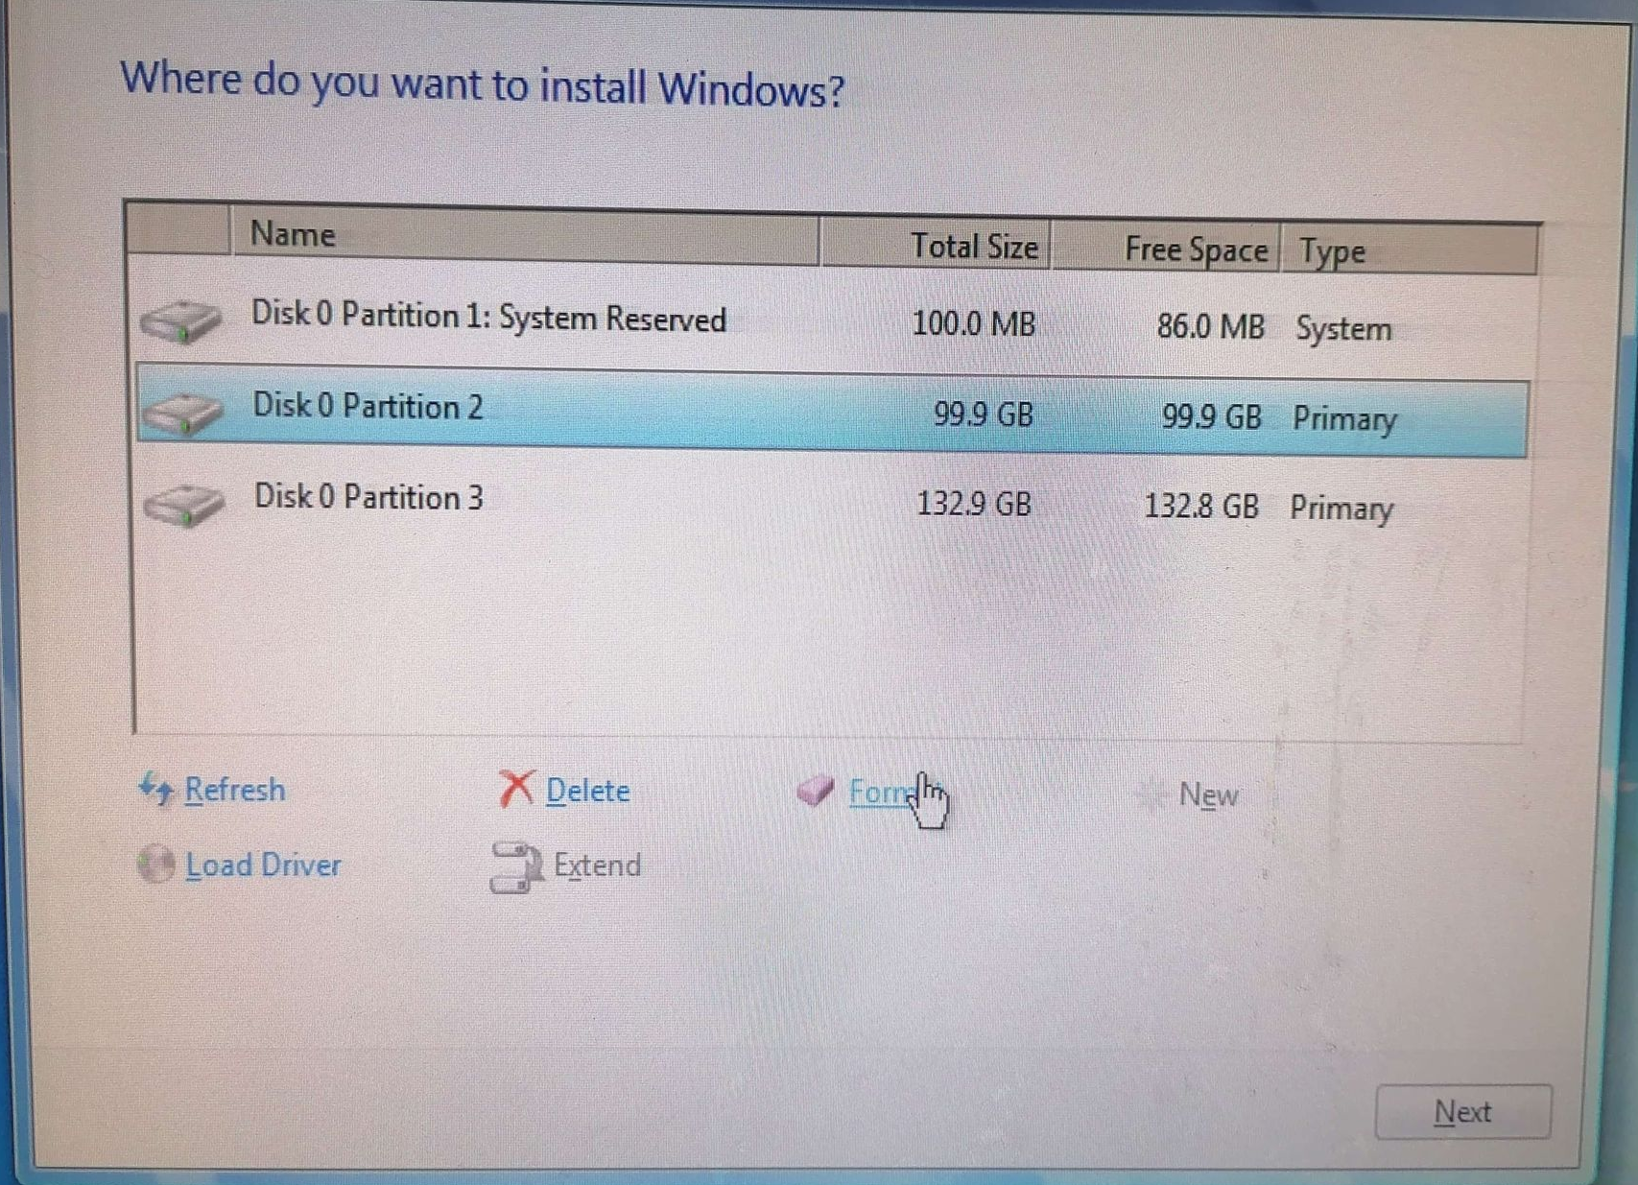
Installation of Windows 7
22. Select Partition 2 or Local C:, then click format

Slide 26
Installation of Windows 7
23. After the Partition 2 or Local C: was formatted then click NEXT

Slide 27
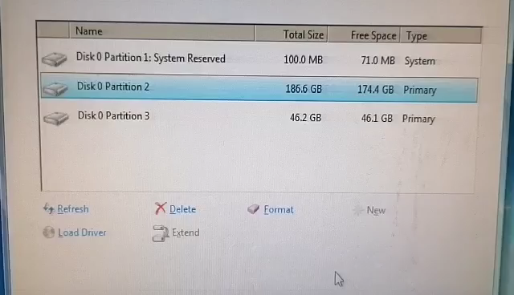
Video in Deleting Partitioning

Slide 28
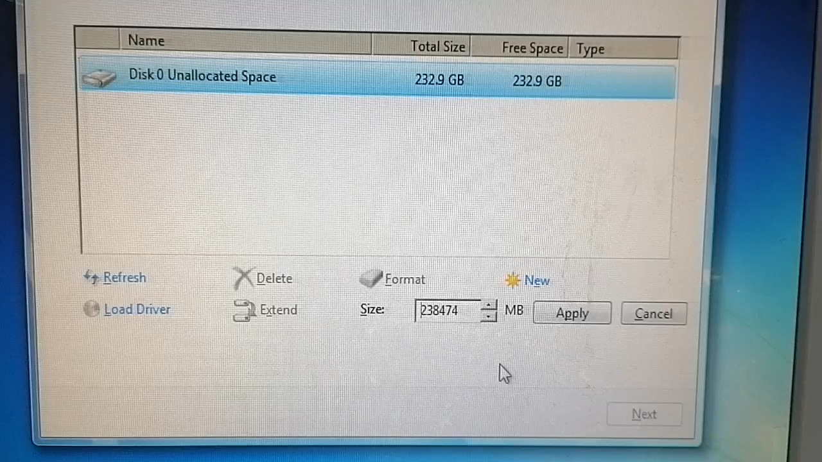
Video in Creating Partitioning

Slide 29
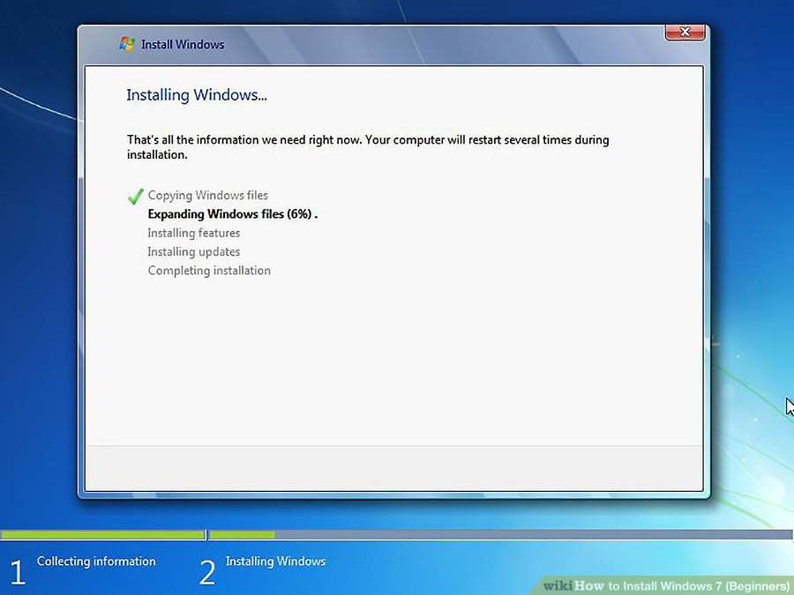
Installation of Windows 7
24. Install Windows on your preferred hard drive and partition. Once you've decided on where to install Windows, select it and click Next. Windows will begin installing.
Note: The Computer will restart after 100%, Go to BIOS Setup to change the booting Priority.

Slide 30
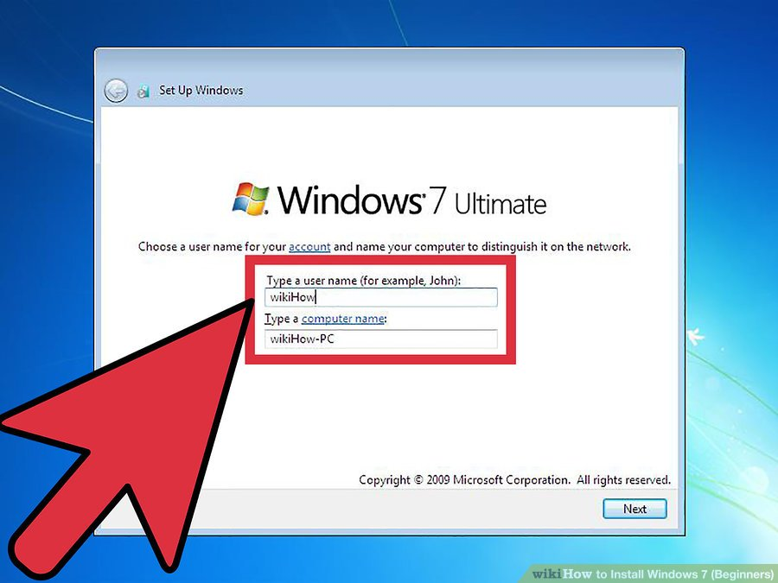
Installation of Windows 7
25. Type your username and computer's name and click Next.

Slide 31
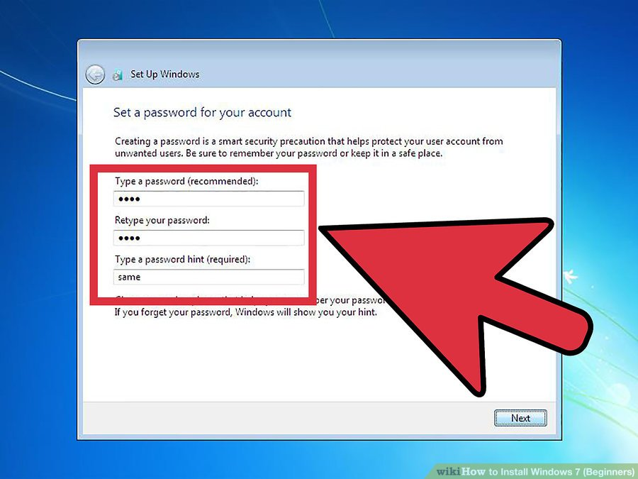
Installation of Windows 7
26. Type your password and click Next. If you don't want a password, leave the text boxes blank and then click Next.

Slide 32
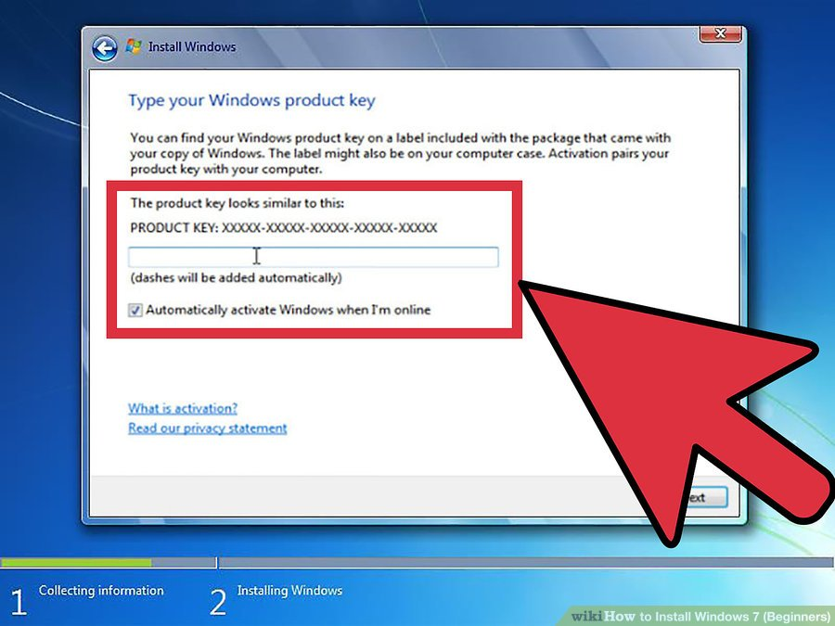
Installation of Windows 7
27. Enter your product key then click Next. Your product key is located on the case of your Windows 7 disc if you purchased the disc. To skip entering your product key, just click Next, but Windows will run on a 30-day trial, and you'll have to enter a key once the 30-day trial time is up.

Slide 33
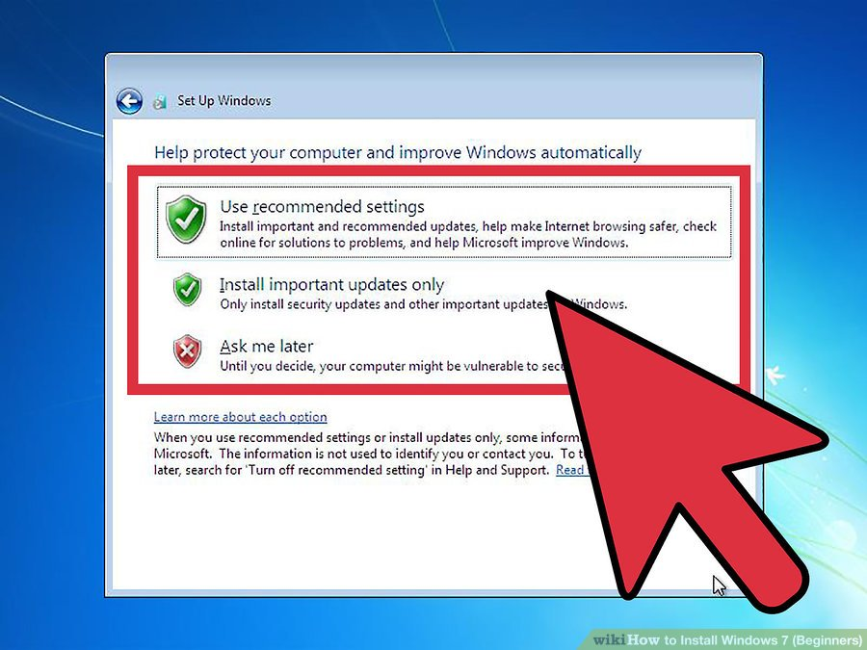
Installation of Windows 7
28. Choose your Windows Update settings.
• Use recommended settings automatically sets update and security settings recommended by Microsoft.

Slide 34
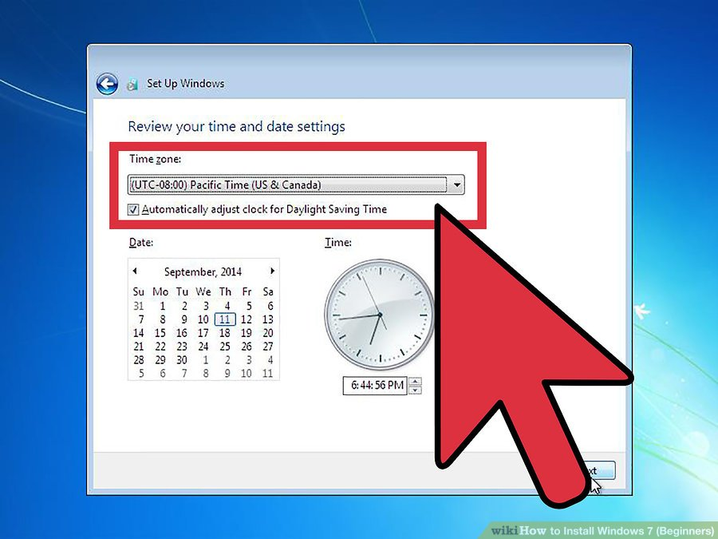
Installation of Windows 7
29. Set your time and time zone.

Slide 35
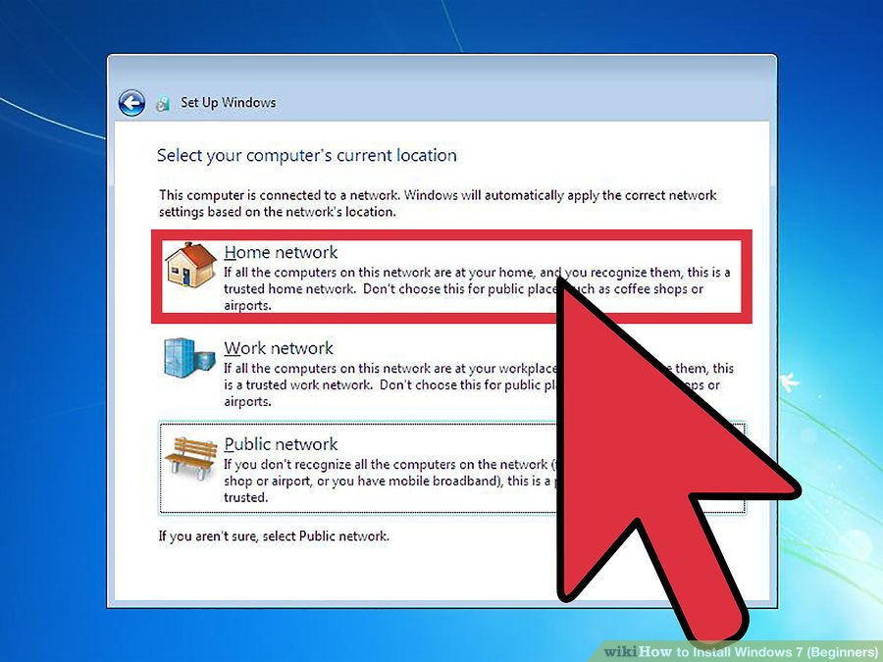
Installation of Windows 7
30. Set your network type.
•If the computer is connected to your own personal network, choose Home network.
•If you are connected to the network at your workplace, choose Work network.
•If you're connected to a public network from places such as restaurants and shops, choose Public network.

Slide 36
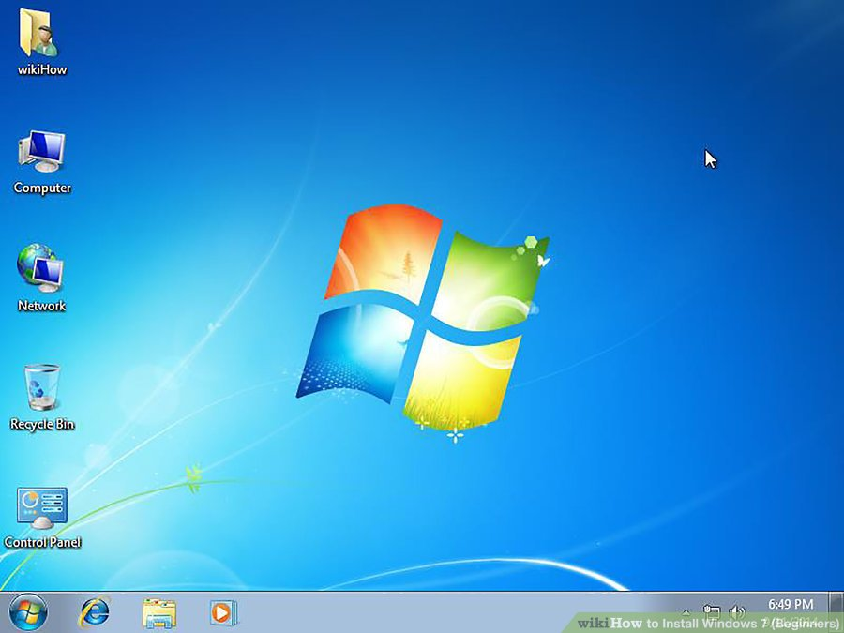
Installation of Windows 7
31. Your computer is now set up!

Slide 37
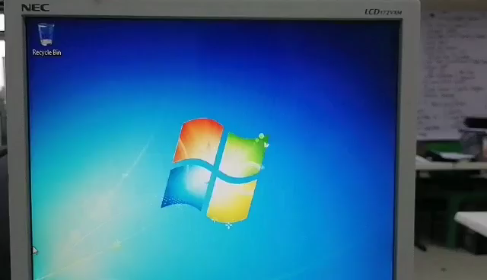
Changing Desktop Icon

Slide 38
THANK YOU !!!

